Slide 1
IOT Smart Plant Monitoring System

Slide 2

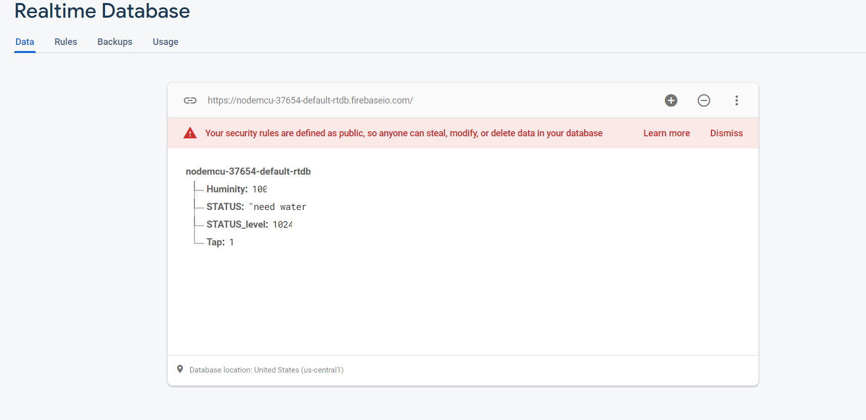
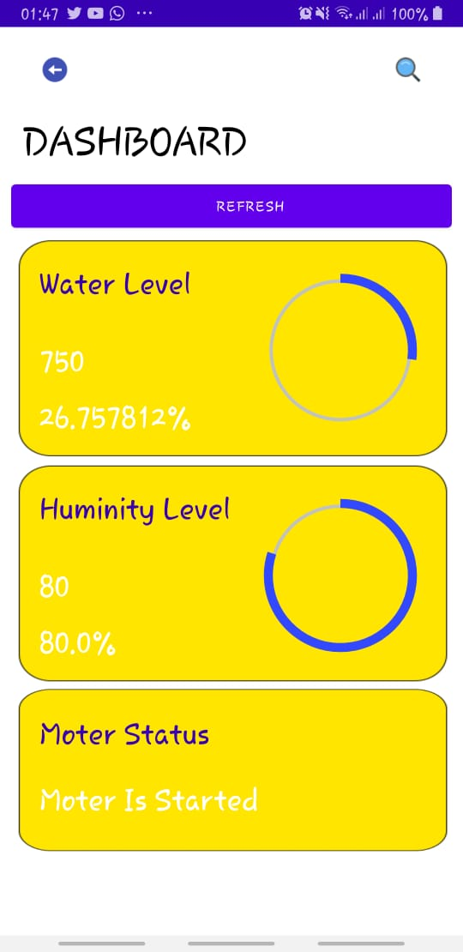
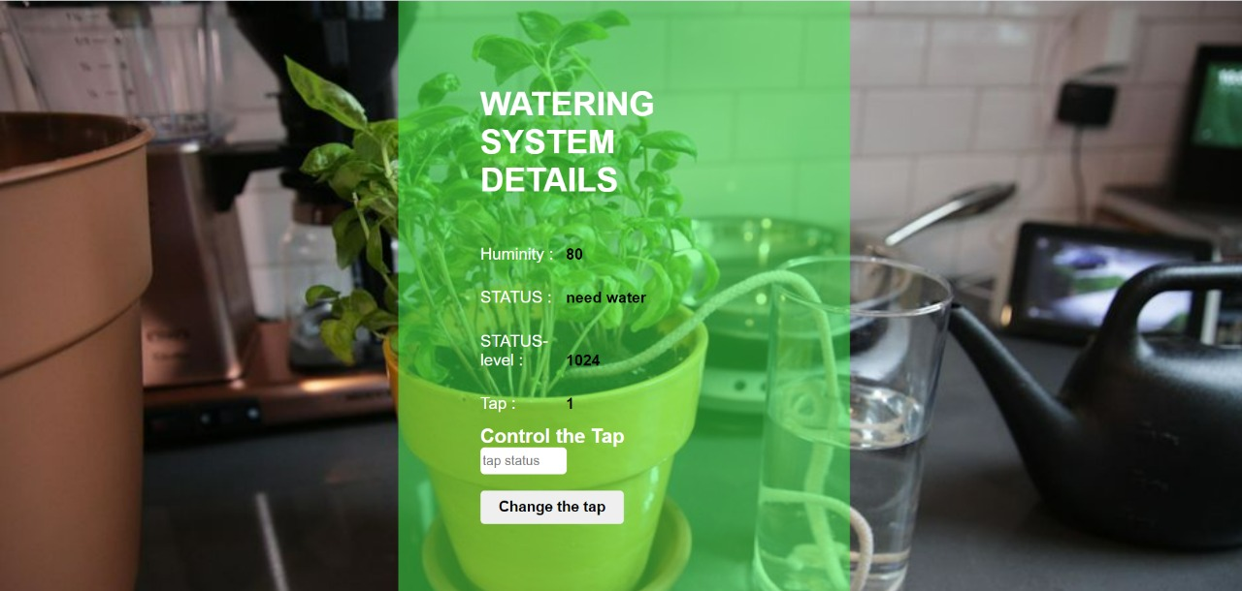
Objective
Our objective was to create a smart plant monitoring system which connects to a:
App
real time database
Web page

Slide 3
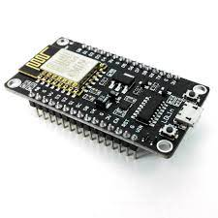
Devices used in our project
ESP8266
The ESP8266 is a low-cost Wi-Fi microchip, with a full TCP/IP stack and microcontroller capability,

Slide 4
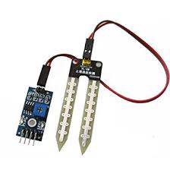
Moisture Sensor
Soil moisture sensors is a sensor which is used to check the amount of water in the soil.
are used in numerous research applications, e.g. in agricultural science and horticulture including irrigation planning, climate research, or environmental science including solute transport studies and as auxiliary sensors for soil respiration measurements.

Slide 5
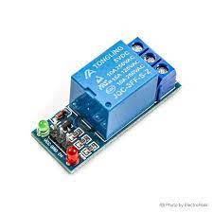
5v Relay Module
5V Relay Module is a relay interface board, it can be controlled directly by a wide range of microcontrollers such as Arduino, AVR, PIC, ARM and so on. It uses a low level triggered control signal (3.3-5VDC) to control the relay

Slide 6
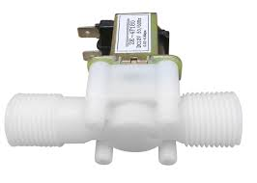
solenoid water valve
solenoid valve is an electro-mechanical valve that is commonly employed to control the flow of liquid or gas. ... Pilot operated valves, the most widely used, utilise system line pressure to open and close the main valve body

Slide 7
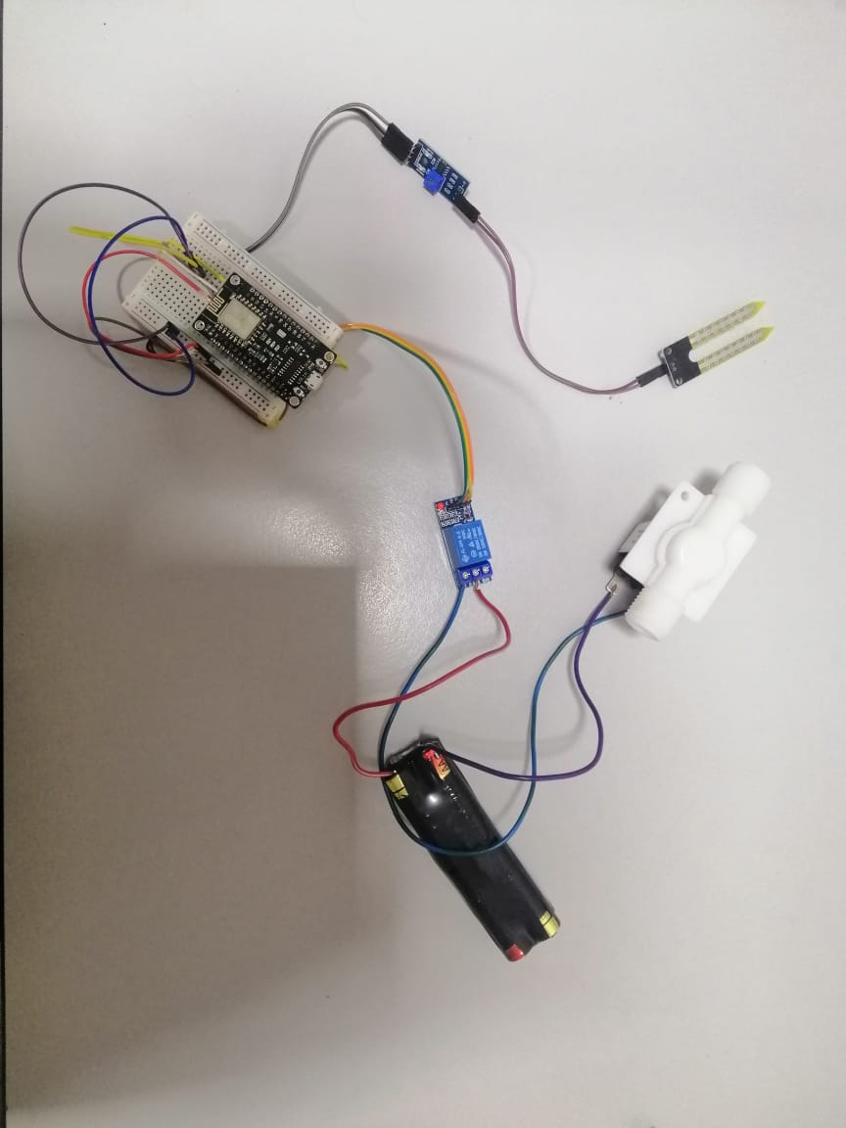
Our Circuit
Our circuit includes
ESP8266
Moisture Sensor
5V Relay Module
Solenoid water valve

